Slide 1
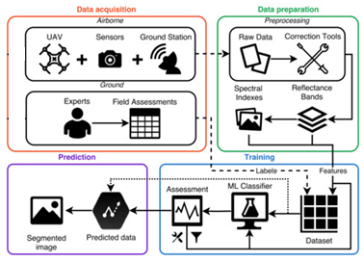
Real-time big data analytics and IoT integration for lake and river conservation management
Problem Statement
Conventional water quality monitoring system: time consuming, laborious, high cost
Method
IoT and real-time data communication, cloud-based fog computing network architecture
Expected Outcome
Real-time water quality monitoring system using IR 4.0 technologies

